Slide 1

Language Model
董永川 2018.10.31

Slide 2
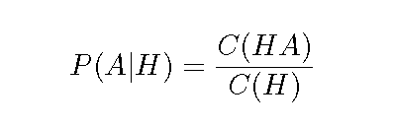
N-gram Model
一个语言模型通常构建为字符串s的概率分布p(s)，这里的p(s)实际上反映的是s作为一个句子出现的概率
这里的概率指的是组成字符串的这个组合，在训练语料中出现的似然，与句子是否合乎语法无关。假设训练语料来自于人类的语言，那么可以认为这个概率是的是一句话是否是人话的概率
p(s)实际求解的是按顺序组成的字符串的联合概率，利用贝叶斯公式，分解如下：
where C(HA) is the number of times that the HA sequence of words has occurred in the training data.
As many of these probability estimates are going to be zero (for all words that were not seen in the training data in a particular context H), smoothing needs to be applied.

Slide 3
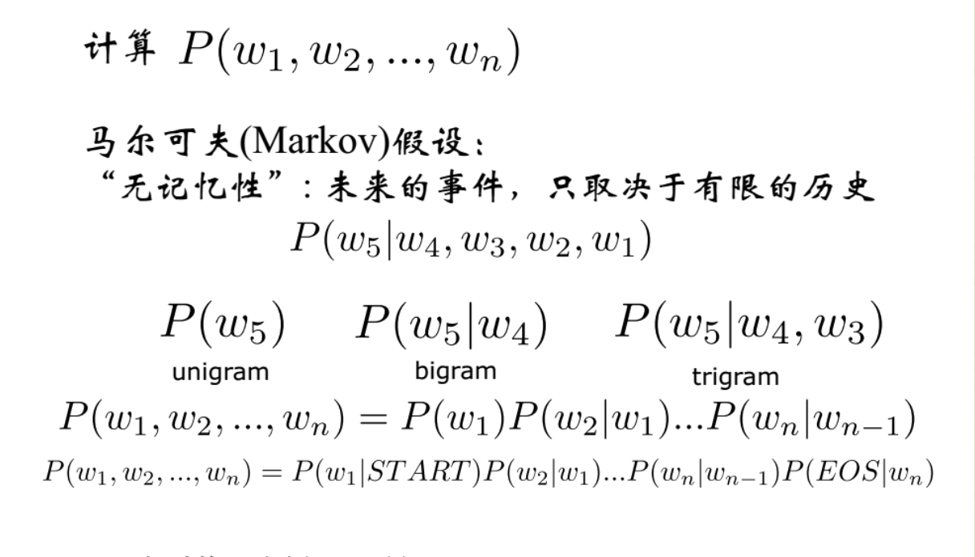
N-gram Model

Slide 4
N-gram Model 缺点
1.自由参数指数级增长
2.考虑的词较少
3.没有考虑词之间的相似性

Slide 5
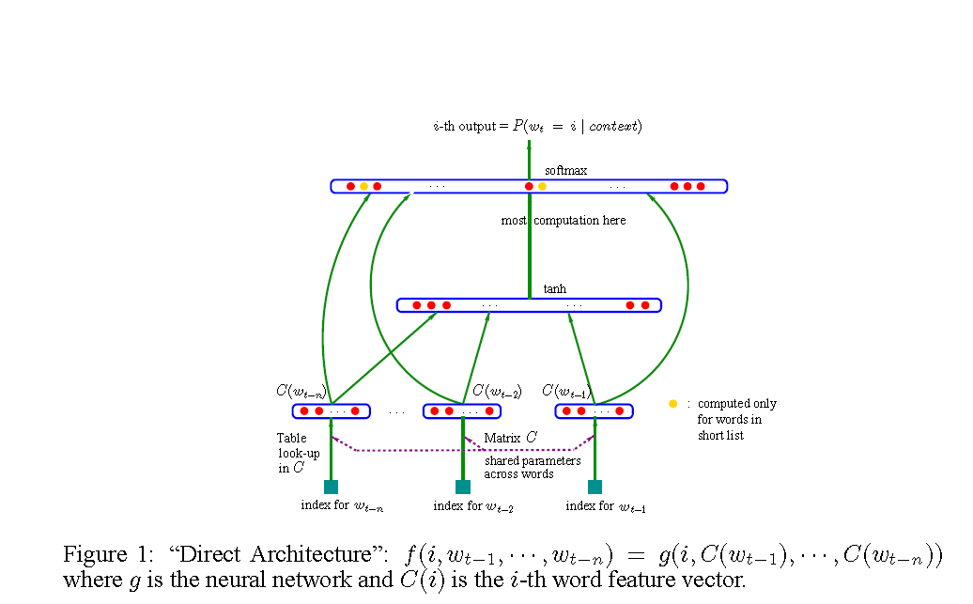

NN Model
1.associate with each word in the vocabulary a distributed “feature vector” (a real valued vector ), there by creating a notion of similarity between words
2. express the joint probability function of word sequences in terms of the feature vectors of these words in the sequence
3. learn simultaneously the word feature vectors and the parameters of that function.

Slide 6
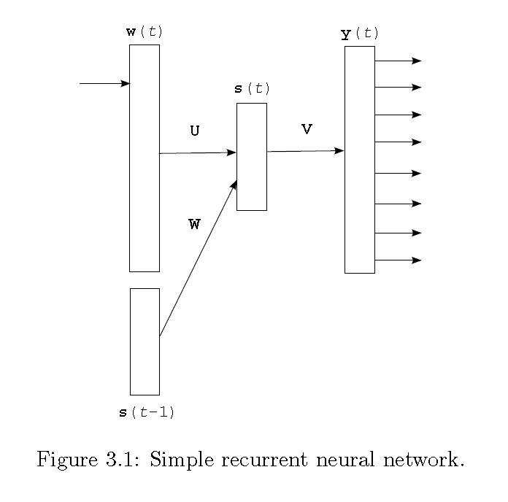
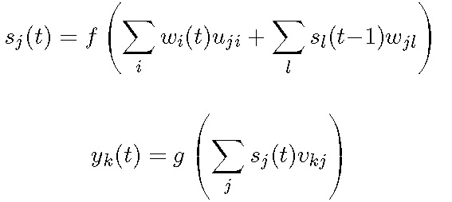
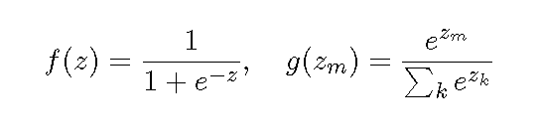



RNN Model

Slide 7
RNN Model
RNN for one epoch is performed as follows:
1. Set time counter t = 0, initialize state of the neurons in the hidden layer s(t) to 1
2. Increase time counter t by 1
3. Present at the input layer w(t) the current word wt
4. Copy the state of the hidden layer s(t􀀀1) to the input layer
5. Perform forward pass as described in the previous section to obtain s(t) and y(t)
6. Compute gradient of error e(t) in the output layer
7. Propagate error back through the neural network and change weights accordingly
8. If not all training examples were processed, go to step 2

Slide 8
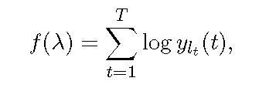








BackPropagation (BP）
objective function.
lt is the index of the correct predicted word for the t sample.

Slide 9
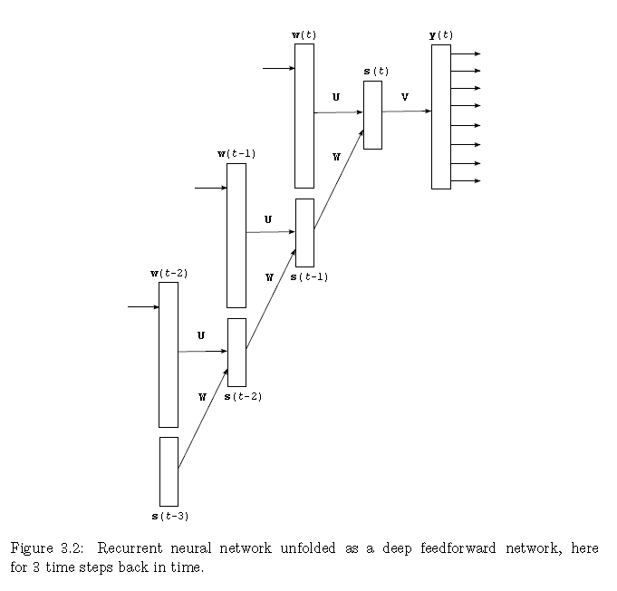
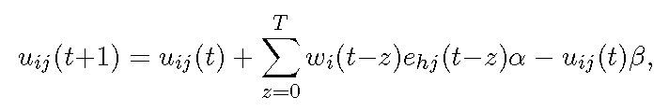
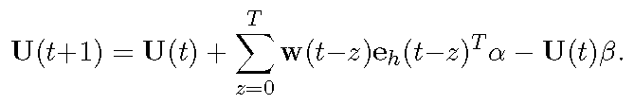
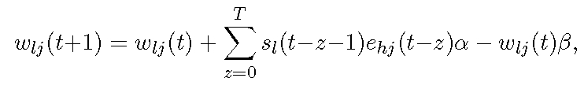
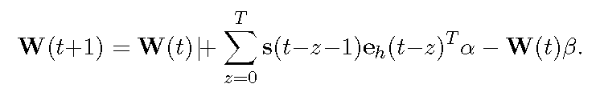
Backpropagation Through Time

Slide 10
THANKS

